Slide 1
μCavLab
— Testable miniature model of autonomous vehicle
Hongfei Chen, Jingyu Chen, Daniel Thomson, Scott Baker, Mohamed Khaled
19th Jan 2018

Slide 2
Overview
Project description and objectives
Milestone and task allocation
Previous stage review
Mechanical part
Control part

Slide 3
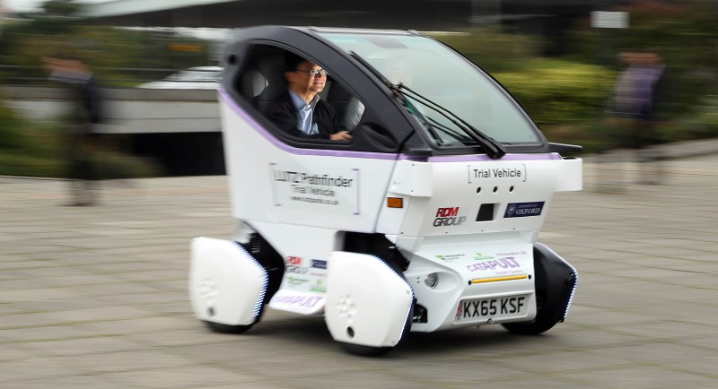
Project description
CavLab is a facility which provides a suitable environment for the testing of these electric vehicles.
μPod is a miniature drive-by-wire vehicle of the full size pod, but 1:6 scale.
Have a compatible interface system in the pod, used as a representative initial testing model for testing the code.
Accessible for more sensors.
A demonstrator in STEM activities.

Slide 4
Project objective
Develop a miniature drive-by-wire vehicle using Ackermann steering mechanism.
Create a μPod such that it uses a drivetrain with a control unit which can be programmed in the same way as the full-size model.
— Same control system ROS (Robert operating system)
— Extensible for more sensors
Use the μPod to test the code and algorithms originally developed for the full-size model.
Realize the motion of the μPod in the real-world within campus.

Slide 5
Pod specifications
190mm track and 200mm wheelbase
90w Brushless motor, Brushless ESC and 6600mAh Li-Po Battery make up the drivetrain
Raspberry Pi3 works as the micro control unit with ROS installed, Arduino uno works as the auxiliary control unit.
Adafruit Ultimate GPS, IMU(Inertial measurement unit) plugged into Pi to read the data
Arduino UNO is the speed control unit
Further options: Pi camera, Ultrasonic sensor with obstacle avoidance realisation

Slide 6
Milestone
Test the vehicle and remedy issues
• Have manufacture close to completion
• Cosmetic housing design
• Completed the vehicle design
• Combine motors, steering input into ROS
• Be familiar with the ROS environment
• Run ROS on the micro control unit to collect data from GPS

Slide 7
Task allocation
• Integrate GPS and speed control together
• Speed control (linkage between mechanical and electrical aspects) -Scott
• GPS route planning (Modulation the process of getting outcome of function K)-Jingyu, Hongfei
• Socket bridge (Communication)
• Mechanical design (Chassis, wheels, dome)- Dan, Mohamed

Slide 8
Previous stage review
Initial design completed, including circuit and the shell of the pod
Be familiar with the ROS system and have initial idea how to expand the design through it
Initial obstacle avoidance achieved while this is suspended for further realization

Slide 9
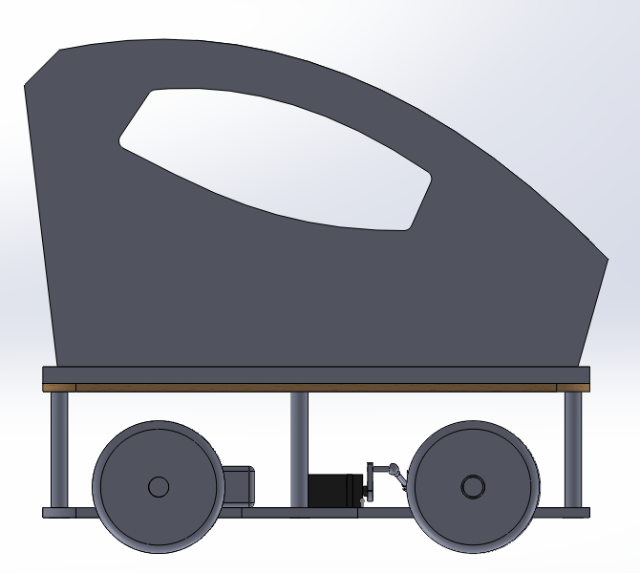
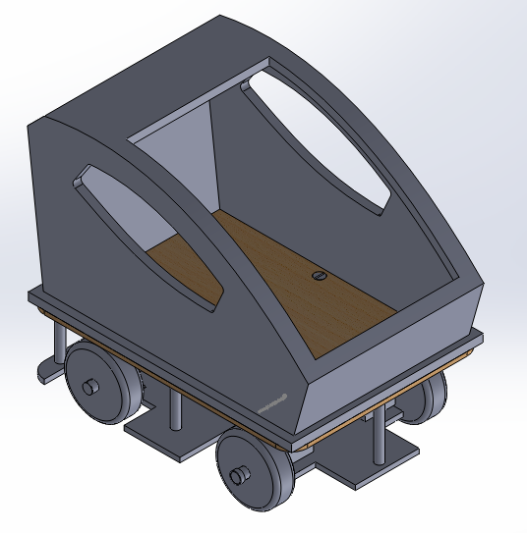
Vehicle Design

Slide 10
Design Developments
The servo attachment and steering rod was developed to make it simpler to manufacture and assemble.
We designed the cosmetic housing to sit on the top platform of the vehicle.

Slide 11
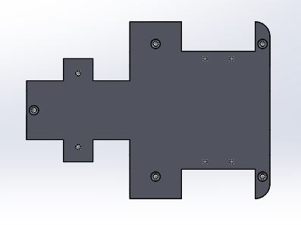
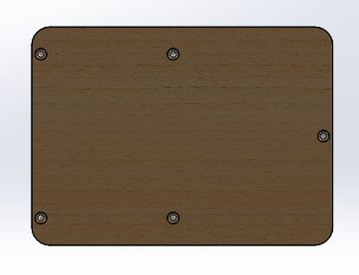
Completed Parts
Main chassis
Support columns
Top level platform
Ackermann joints
Ackermann steering rods

Slide 12
Manufacturing
After completing the designs and improvements the parts were ready for the manufacturing stage.
In order to get the parts manufactured, we had to convert the 3D parts into 2D mechanical drawings.
These were then handed into the workshop for manufacture.
Examples of these drawings are shown on the next slide.

Slide 13
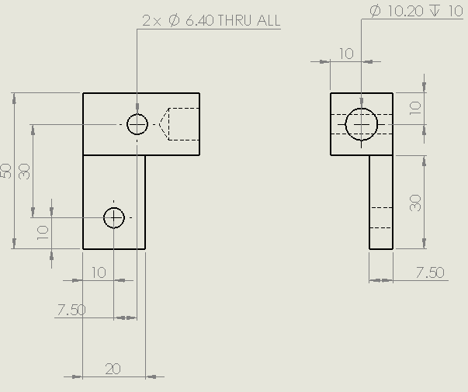
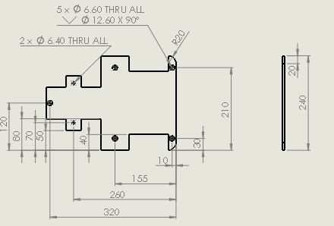
Example Drawings
Bottom chassis

Slide 14
Parts Requiring Attention
Driveshaft
Rear axle bearing housing
Rear axle wheel rod joints
Wheel rods cut to size
Steering rod cut to size

Slide 15
Next Steps
Hand the remaining drawings into the workshop, only the simpler parts remaining.
Decide upon the placement of the electronic components on the top platform and drill holes for the wires.
Begin to assemble the vehicle.

Slide 16
Speed Control and Drivetrain
Using brushless motor and ESC for precise motor control
Hall effect sensor on a front wheel
To do:
Return and re-order ESC
Solder connectors and wires

Slide 17
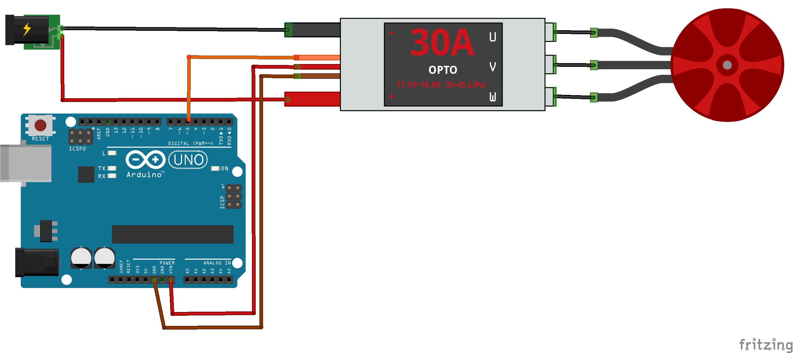
Speed Control and Drivetrain —test

Slide 18
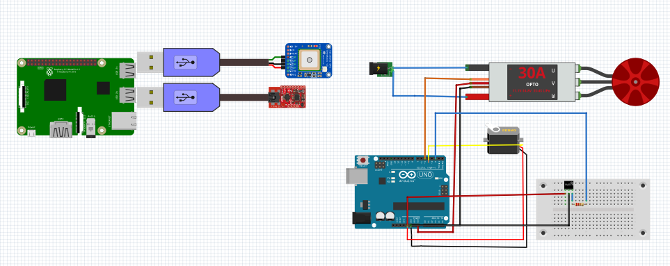
Updated control system
Hall sensor
ESC+motor
Servo
GPS
IMU

Slide 19
Speed Control and Drivetrain —ros_arduino_bridge stack
The Arduino microcontroller can only run one ROS node at a time.
The Raspberry pi 3 only has one hardware PWM ports even though the GPIO ports can output PWM signal by manipulating.
Therefore, integrating ESC, servo, hall sensor(wheel encoder) on the Arduino as Speed control module is the solution.

Slide 20
Speed Control and Drivetrain —ros_arduino_bridge stack
The stack includes a base controller for a differential drive robot that accepts ROS Twist messages and publishes odometry data back to the PC.
Features of the stack include:
Can also read data from generic analog and digital sensors
Support for PWM servos
Can control digital outputs (e.g. turn a switch or LED)
Configurable base controller if using the required hardware
Challenge: do not have the hardware required to run the base controller, follow the instructions to use your Arduino-compatible controller to read sensors and control PWM servos.

Slide 21
Speed Control and Drivetrain —ros_arduino_bridge stack
ros arduino bridge stack includes:
ros_arduino_bridge: include stack file and cmake configuration file CMakeLists.txt
ros_arduino_firmware: firmware command to drive the hardware
ros_arduino_msgs: custom ROS message types and services
ros_arduino_python: take charge for communication with hardware drive program
Modification: ros_arduino_bridge.ino, moto_driver.ino, encoder_driver.ino
Steps: Add Macro in ros_Arduino_bridge, define new if…else command in moto_driver.ino, add necessary statement in motor_driver.h

Slide 22
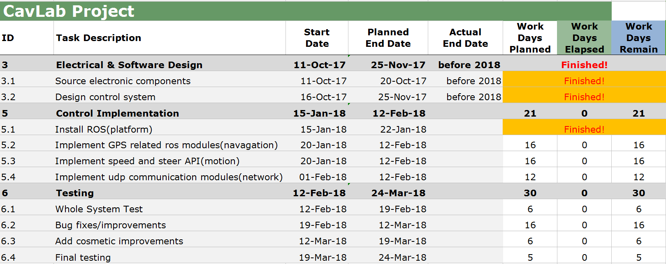
Software and Control part
Gantt chart plan

Slide 23
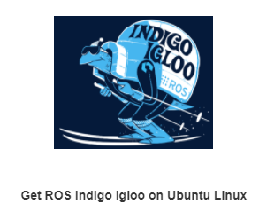
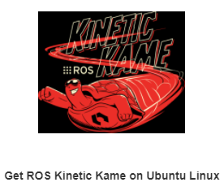
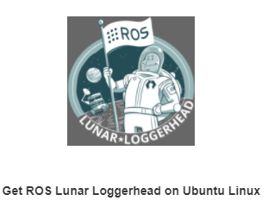
Key Results
Platform establishment
In the official website, it has three versions of ROS environment.
We choose kinetic because it is the latest version and is compatible with ubuntu 16.04
First attempt: first install ubuntu 16.04 and then install ROS kinetic (complicated )
Final choice: install integrated SD Card Image with Ubuntu Mate 16.04 and ROS Kinetic (easy to use)

Slide 24
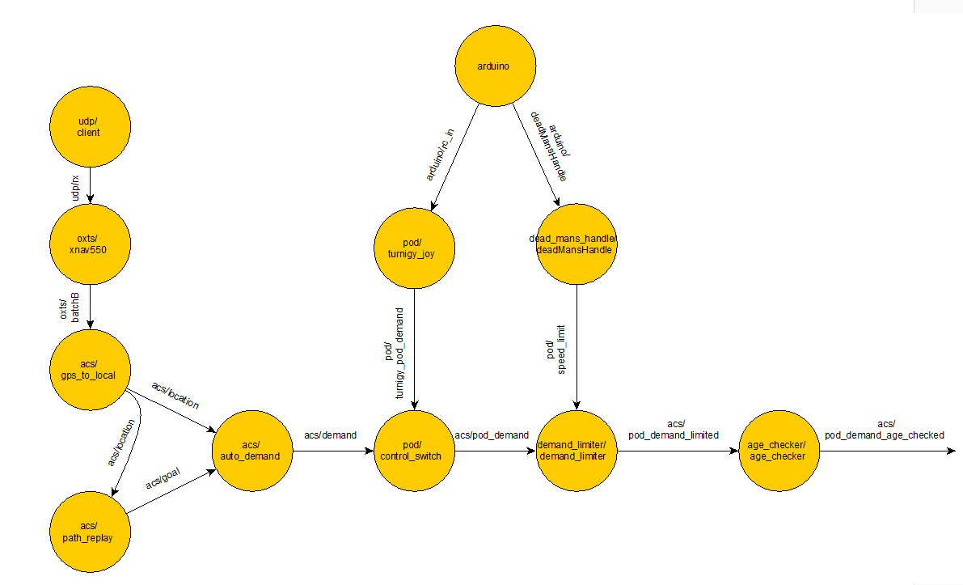
2. Code hacking ​
A
B
C
A. Navigation
B. central control
C. motion

Slide 25
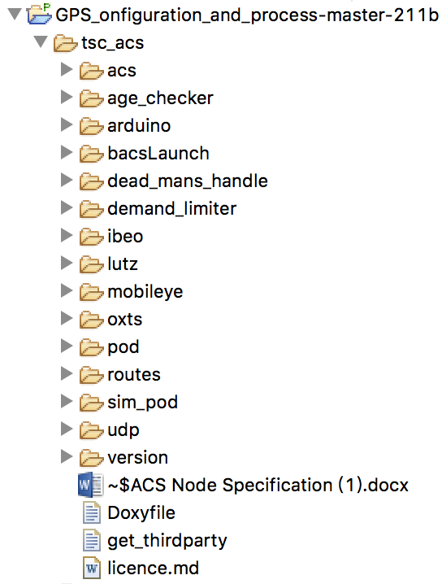
Reverse Engineering
Although this code is very comprehensive, we have to make our ROS nodes based our vehicle.
Oxts GPS → adafruit GPS
Ibeo lidar → cheap lidar
Mobileye→ another camera(optional)
In Lutz node, only choose the essential hardware component :
/imu /esc_motor /servo_steering /wheel_encoder
Udp →TCP
We may use TCP for the communication between the PC and rpi.

Slide 26
Initial Structure of nodes
adruino
gps/adfruit
laser/scan
pod/joyfun
acs/GpsTolocal
odm/imu
/lutz/motor
/odm/tflocal
acs/auto_demand
pod/control_switch
odm/encoder
/lutz/servo
acs/path_goal

Slide 27
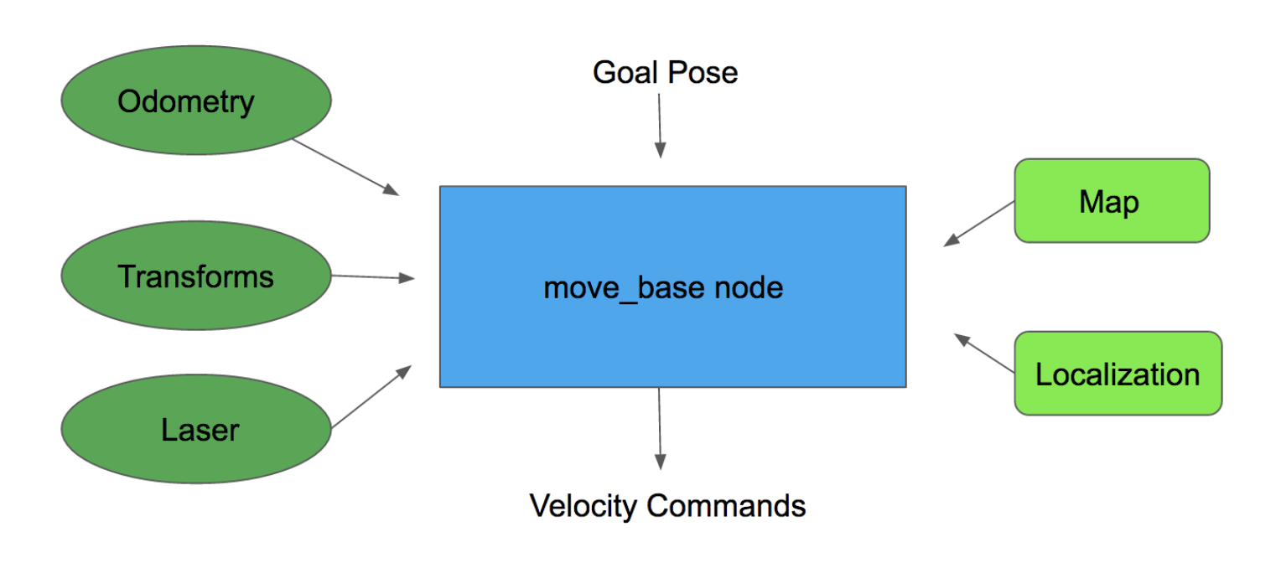
3. Navigation implementation
For navigation module, we will use ROS navigation stack. Now we have achieved the process of integrating GPS data.
First use Navsat_transform_node as input a nav_msgs/Odometry message , a sensor_msgs/Imu containing an accurate estimate of your robot’s heading, and a sensor_msgs/NavSatFix message containing GPS data. It produces an odometry message in coordinates that are consistent with your robot’s world frame.

Slide 28
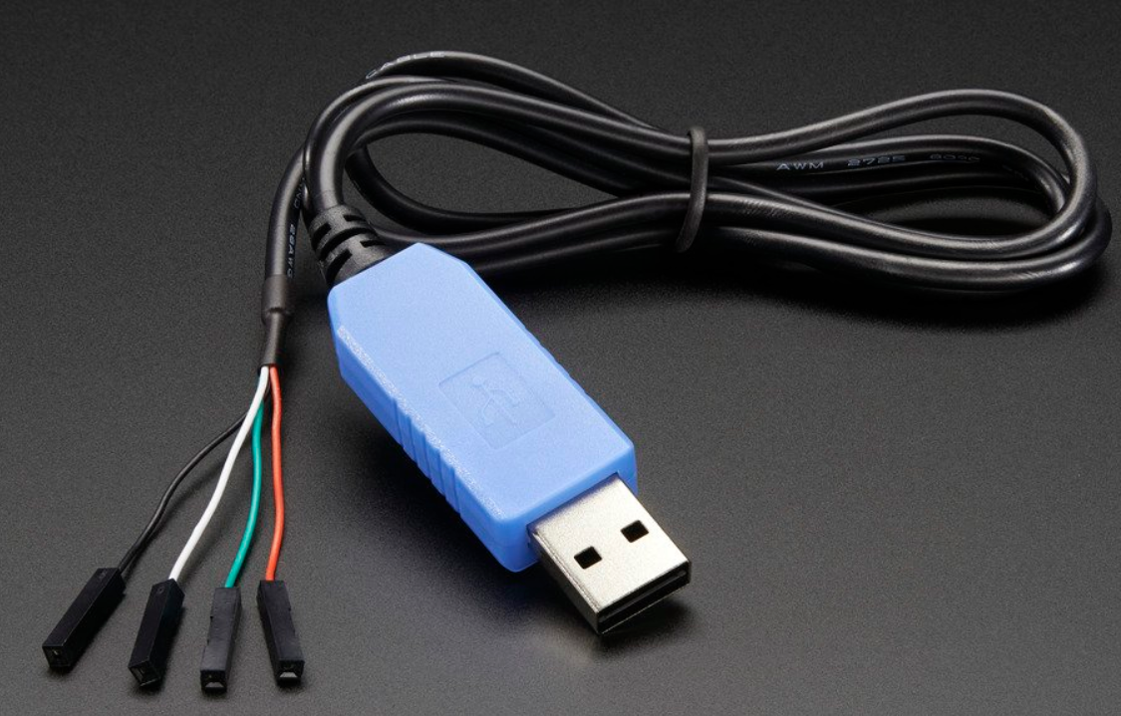
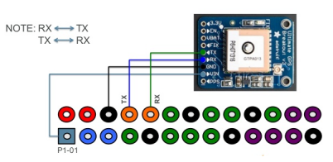
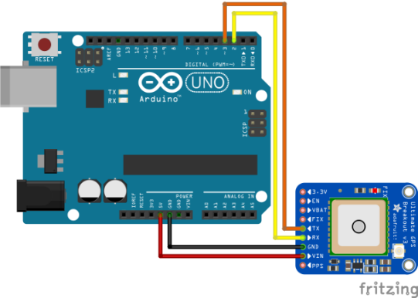
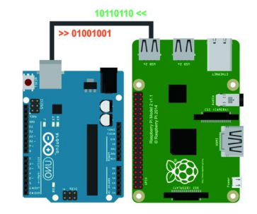
Reading data from GPS , Three plans to do it :
Three plans:
Raspberry pi3 connects to GPS through USB
Raspberry pi3 connects to GPS through serial port
Raspberry pi3 connects to GPS through Arduino(GPS connects to Adruino)

Slide 29
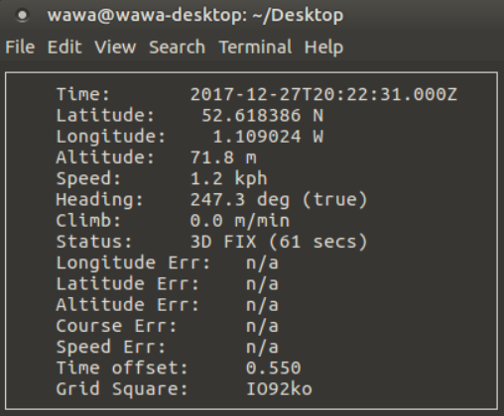
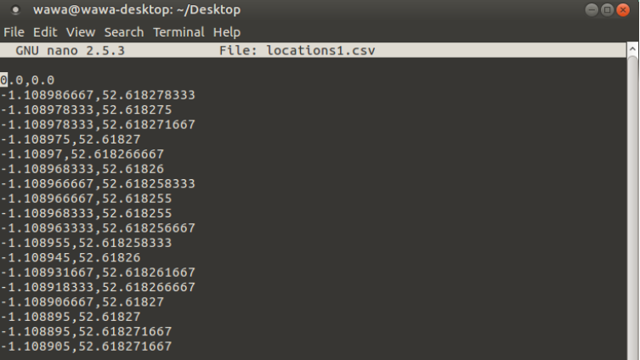
Processing on data on rpi3
The first step is to read data from /ttyUSB0 through gpsd daemon
format.py
Gpsd socket
Latitude and longitude.cvs
•Secondly, use nmea_navsat_driver ROS package
Package to parse NMEA strings and publish a very simple GPS message

Slide 30
Next Steps
Test the speed control unit and servo on Arduino with ros_arduino_bridge stack when the ESC arrives
Integrate IMU data with GPS data within navigation stack.

Slide 31
Thanks for watching

